Slide 1
Medical Image Segmentation
Skin Lesion Segmentation and Classification
Yash Sahitya 18BIT121
Neel Gandhi 18BIT078
Debayan Rakshit 18BIT014
Shobhit Sinha 18BIT103
Harikrishna Patel 18BIT133D
Jay Patel 18BIT116

Slide 2
Introduction
Skin cancer represents a serious public health problem because of its increasing incidence and subsequent mortality. Among skin cancers, malignant melanoma is by far the most deadly form.
As the early detection of melanoma significantly increases the survival rate of the patient, several non-invasive imaging techniques, such as dermoscopy, have been developed to aid the screening process .
Dermoscopy involves the use of an optical instrument paired with a powerful lighting system, allowing the examination of skin lesions in a higher magnification. Therefore, dermoscopic images provide a more detailed view of the morphological structures and patterns as compared to the normally magnified images of the skin lesions.

Slide 3
Problem Statement
In this project, we intend to exploit the properties and model architectures for:
Segmentation of Skin Lesions from Dermoscopic images.
Classification of dermoscopic images into different categories and determining whether the predicted class of skin disease is ‘Benign’ or ‘Malignant’.
The project examines the accuracy of the proposed technique together with the adoption of the proposed pre-processing method.
We also benchmark our proposed scheme with other available methods by way of results through network accuracy, Jaccard Index, Dice score, and other performance metrics that aid us in comparison.

Slide 4
Problem Definition
Skin lesion segmentation in dermoscopic images is a challenging task due to the low contrast between lesion and the surrounding skin, the irregular and fuzzy lesion borders, the existence of various artifacts, and various imaging acquisition conditions.
In this project, we present a fully automatic method for skin lesion segmentation by leveraging UNet and FCN that is trained end to-end. For Skin lesion disease classification, we use a customized convolutional neural net.
Designing a novel loss function based on Jaccard distance to eliminate the need of sample re-weighting, a typical procedure when using cross entropy as the loss function for image segmentation due to the strong imbalance between the number of foreground and background pixels.
We also evaluated the effectiveness, efficiency, as well as generalization capability of the proposed framework on publicly available PH2 database and HAM10000 dataset.

Slide 5
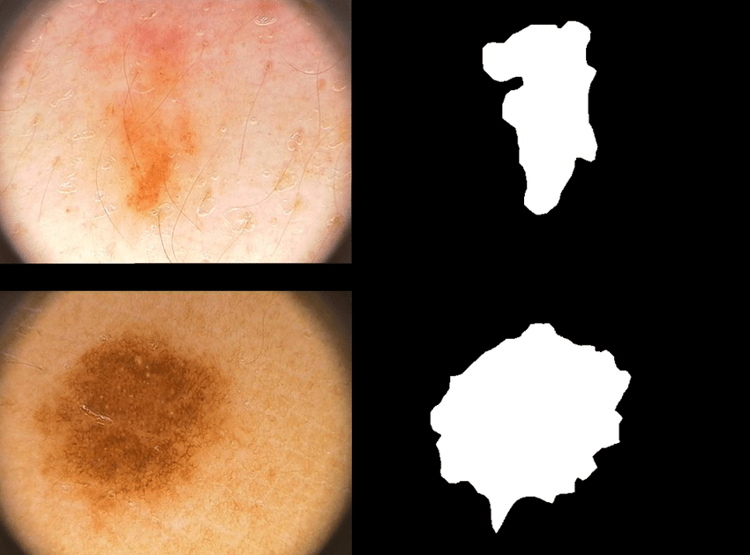
Datasets
PH² :
The PH² dataset has been developed for research and benchmarking purposes, in order to facilitate comparative studies on both segmentation and classification algorithms of dermoscopic images.
PH² database contains a total of 200 dermoscopic images of melanocytic lesions, including 80 common nevi, 80 atypical nevi, and 40 melanomas with dimensions 768x560 pixels.

Slide 6
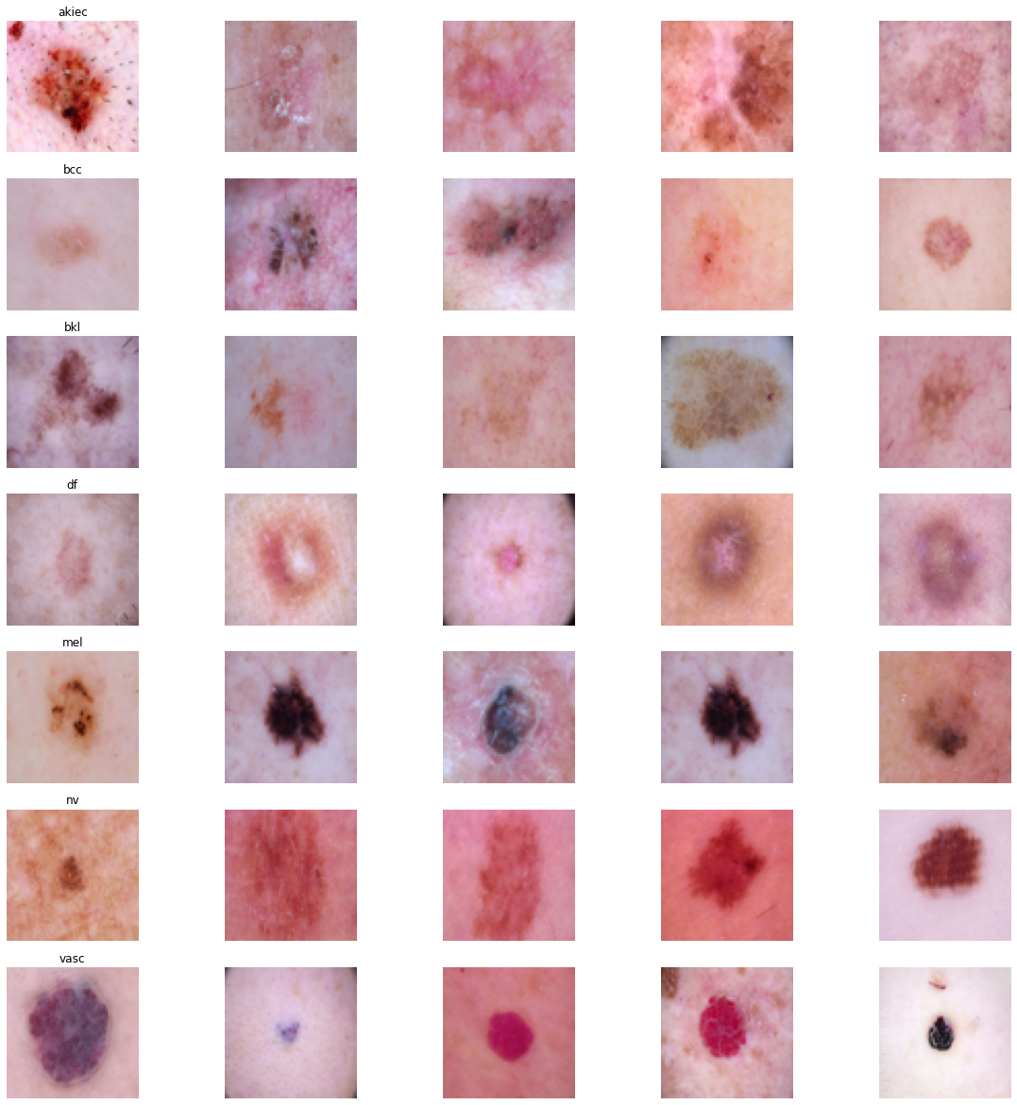
Datasets
HAM10000 :
Training of neural networks for automated diagnosis of pigmented skin lesions is hampered by the small size and lack of diversity of available dataset of dermatoscopic images.
HAM10000 dataset consists of 10015 dermatoscopic images which can serve as a training set for academic machine learning purposes. The dimension of images in this dataset is 600x450 pixels.

Slide 7
Literature Survey
Researchers have developed various computer algorithms to conquer these challenges. These algorithms can be broadly classified as clustering, thresholding, region merging and splitting, active contour models and supervised learning.
Meanwhile, pre-processing steps, such as color space transform, contrast enhancement, lesion localization and artifact removal are usually introduced to facilitate the lesion segmentation procedure .
Recently, convolutional neural networks (CNNs) have become one of the most powerful tools in machine learning and computer vision. These models have the capability of learning hierarchical features in skin lesion from nondermoscopic images.

Slide 8
Literature Survey
Sr No.
1 | Peruch et al.proposed a Mimicking Expert Dermatologists’ Segmentation (MEDS) method, in which Principal Component Analysis (PCA) is firstly applied to project the RGB images onto the first principal component of the color histogram, then a thresholding technique that mimicks the cognitive process of human dermatologists is used to cluster the colors (and thus pixels) into lesional and non-lesional skin. Thresholding-based methods rely on the histogram distribution of image color (or its variants), which may be undesirably altered in cases when significant amount of hair and bubbles are present. | Peruch et al.
2 | In order to improve the effectiveness of the classic GVF snake in the presence of distractions or noise in the vicinity of a real boundary, Zhou et al. integrated a mass density function into the optimization objective functional, which can be solved with the support of mean shift estimation. The optimization procedure, however, involves a large amount of computation to achieve convergence. | Zhou et al.

Slide 9
Literature Survey
Sr No.
3 | Sadri et al. introduced a fixed-grid wavelet networks in which orthogonal least squares was used to calculate the network weights and to optimize the network structure in a supervised way. | Sadri et al.
4 | Another supervised method was proposed by Xie et al. in, where a self-generating neural network is combined with the genetic algorithms for skin lesion segmentation. These supervised methods, along with the aforementioned unsupervised ones, employ hand-crafted features that require specialized domain knowledge. | Xie et al

Slide 10
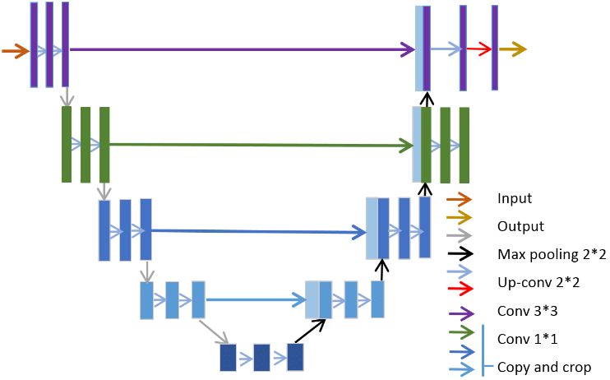
Proposed Methodology for Skin Lesion Segmentation
U-Net in biomedical image segmentation.
The network consists of a contracting path and an expansive path, which gives it the u-shaped architecture. The contracting path is a typical convolutional network that consists of repeated application of convolutions, each followed by a rectified linear unit (ReLU) and a max pooling operation. During the contraction, the spatial information is reduced while feature information is increased. The expansive pathway combines the feature and spatial information through a sequence of up-convolutions and concatenations with high-resolution features from the contracting path.

Slide 11
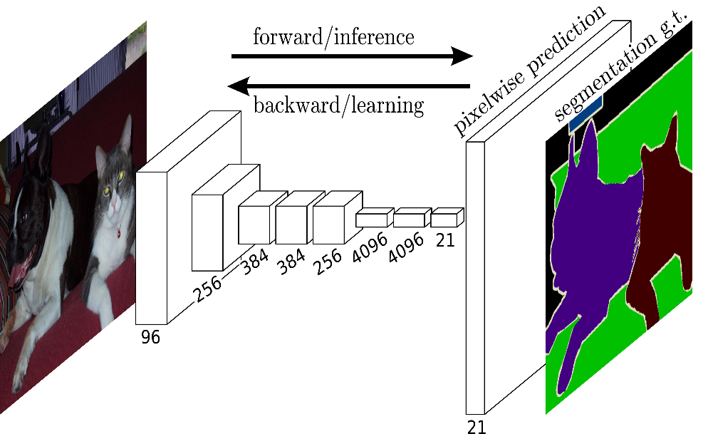
Proposed Methodology for Skin Lesion Segmentation
Fully Convolutional Networks, or FCNs, are an architecture used mainly for semantic segmentation. They employ solely locally connected layers, such as convolution, pooling and up sampling. Avoiding the use of dense layers means less parameters (making the networks faster to train). It also means an FCN can work for variable image sizes given all connections are local.
The network consists of a down sampling path, used to extract and interpret the context, and an up sampling path, which allows for localization.
FCNs also employ skip connections to recover the fine-grained spatial information lost in the down sampling path.

Slide 12
Proposed Methodology for Skin Lesion Classification
The proposed architecture of Convolutional Neural Network for Skin Lesion Classification is shown as below:

Slide 13
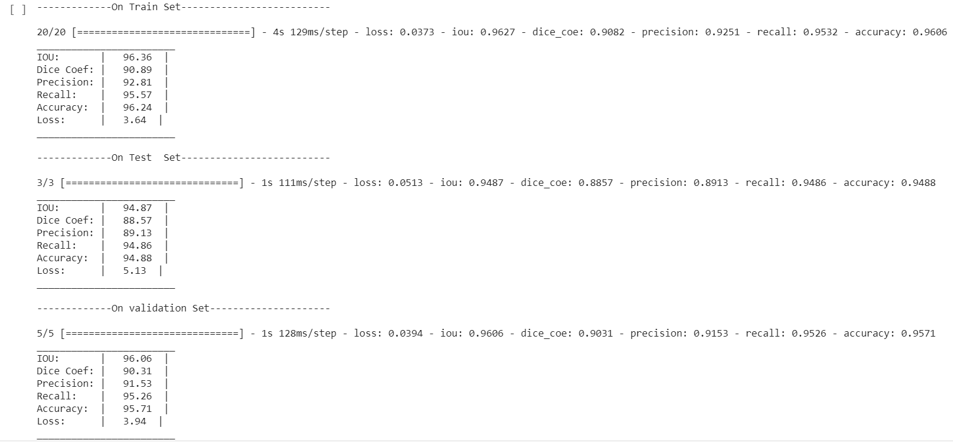
Results of Skin Lesion Segmentation(UNet)

Slide 14
Results of Skin Lesion Segmentation(UNet)
Train Set
Test Set
Parameters | Values
IOU: | 95.06
Dice Coeff: | 77.43
Precision: | 95.67
Recall: | 93.37
Accuracy: | 96.57
Loss: | 4.94
Parameters | Values
IOU: | 94.08
Dice Coeff: | 76.05
Precision: | 91.94
Recall: | 92.89
Accuracy: | 95.22
Loss: | 5.92

Slide 15
Post processing
Currently the predicted outputs were blurry because the predicted pixel values are in the range 0 - 1.
To make clear edge predictions and we enhance our image by rounding up the pixel values to 1 which are > 0.5 .
While rounding down the pixel values to 0 which are < 0.5.
We can enhance the image to look for absolute shape predicted by ceiling and flooring the predicted values.

Slide 16
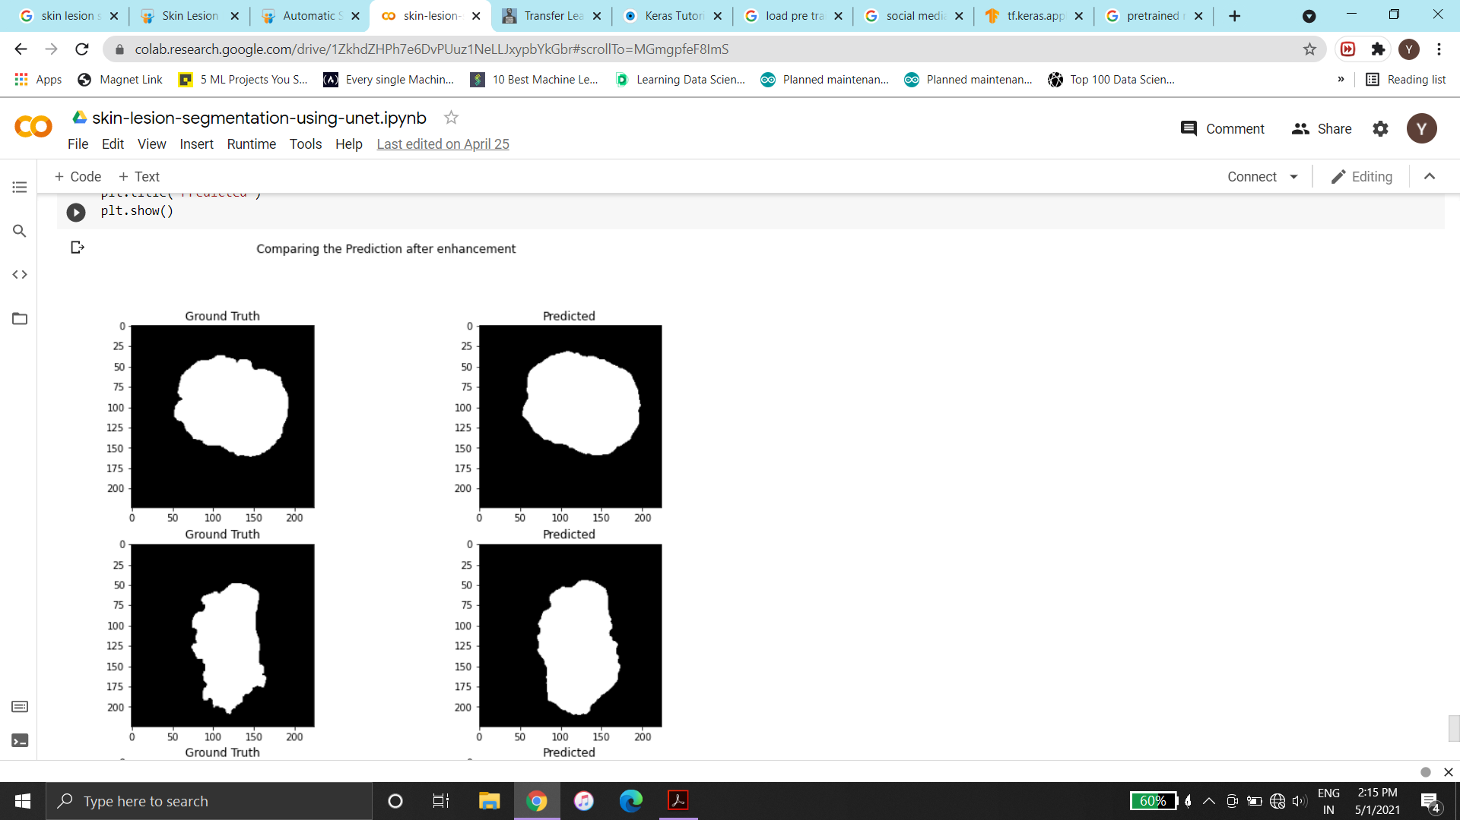
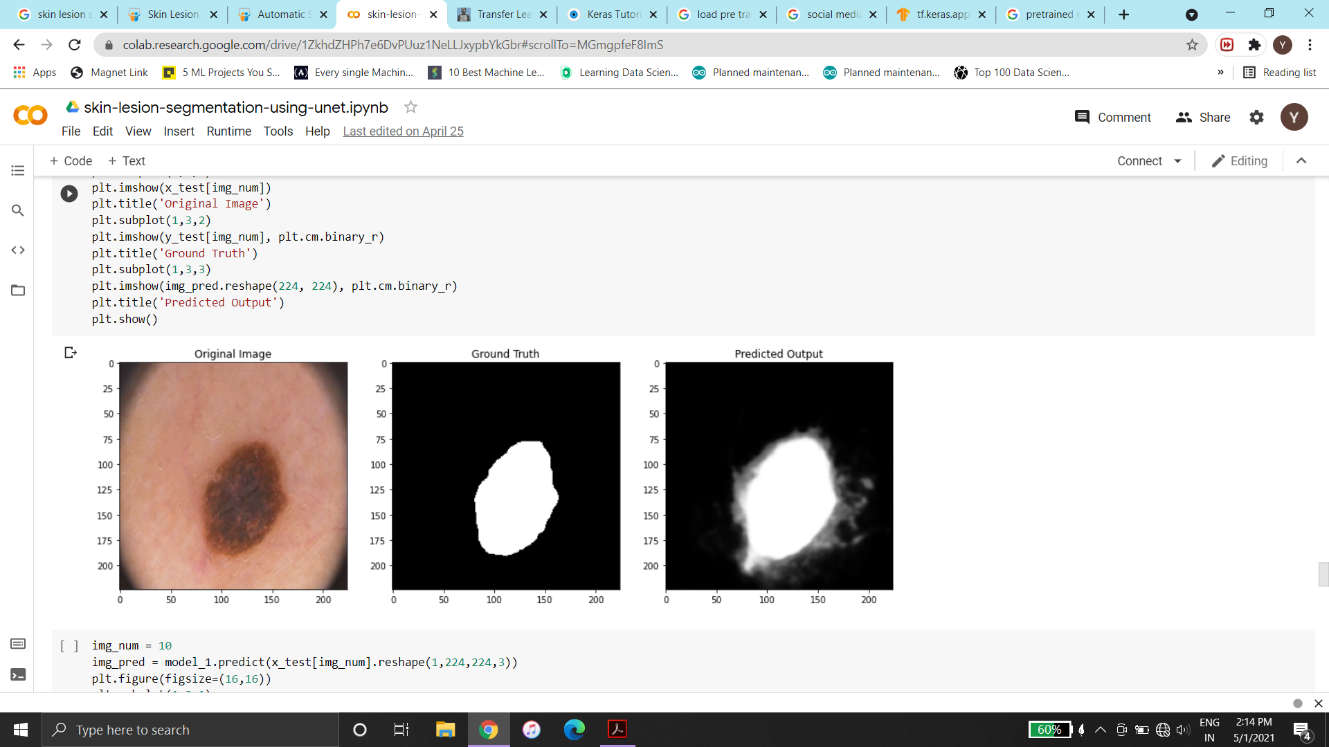
Results of Skin Lesion Segmentation(UNet)

Slide 17
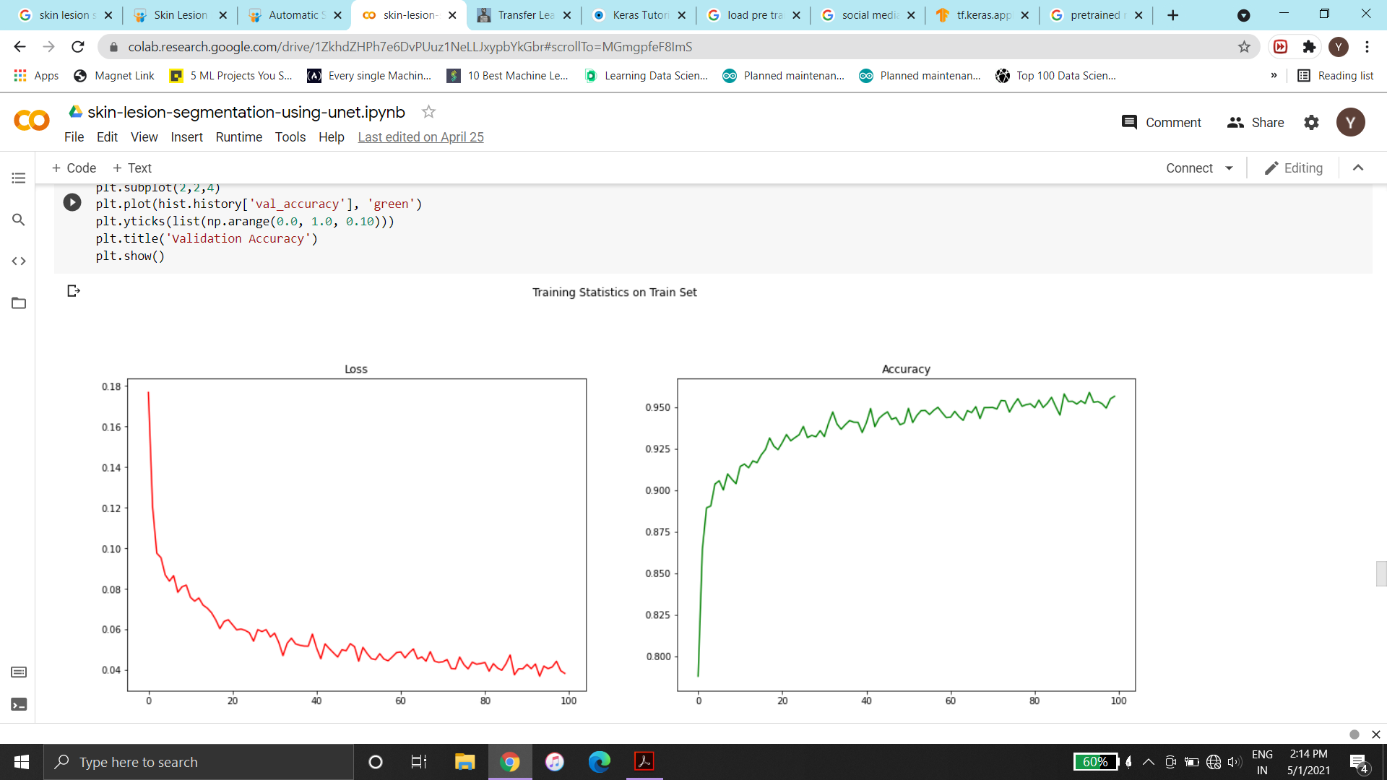
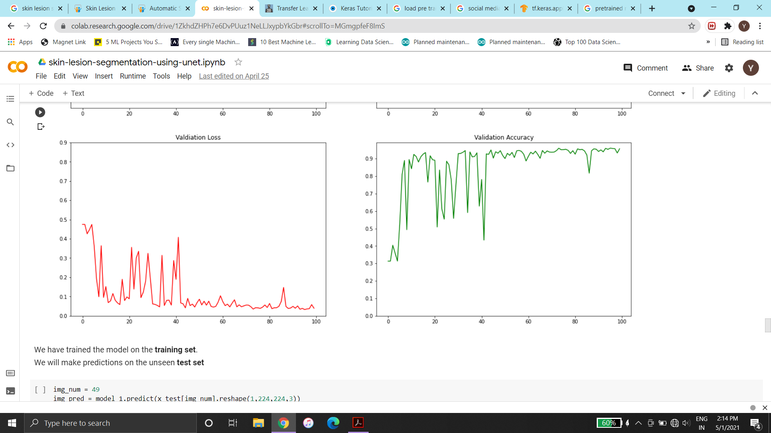

Slide 18
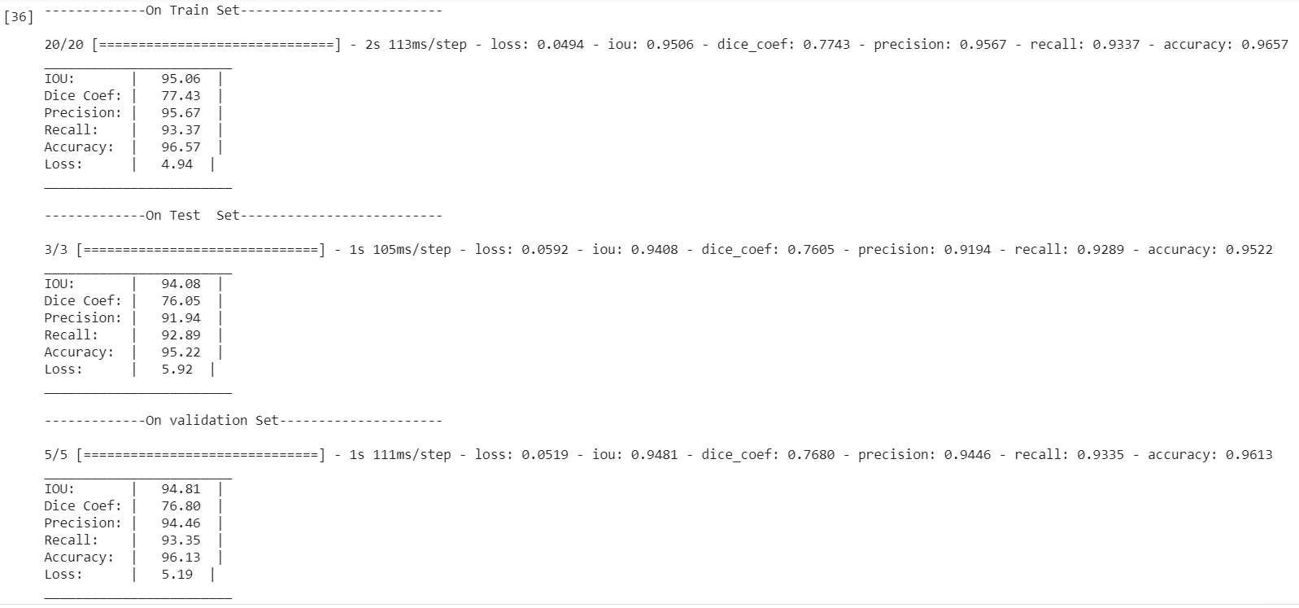
Results of Skin Lesion Segmentation(FCN)

Slide 19
Results of Skin Lesion Segmentation(FCN)
Train Set
Test Set
Parameters | Values
IOU: | 96.36
Dice Coeff: | 90.89
Precision: | 92.81
Recall: | 95.57
Accuracy: | 96.24
Loss: | 3.64
Parameters | Values
IOU: | 94.87
Dice Coeff: | 88.57
Precision: | 89.13
Recall: | 94.86
Accuracy: | 94.88
Loss: | 5.13

Slide 20
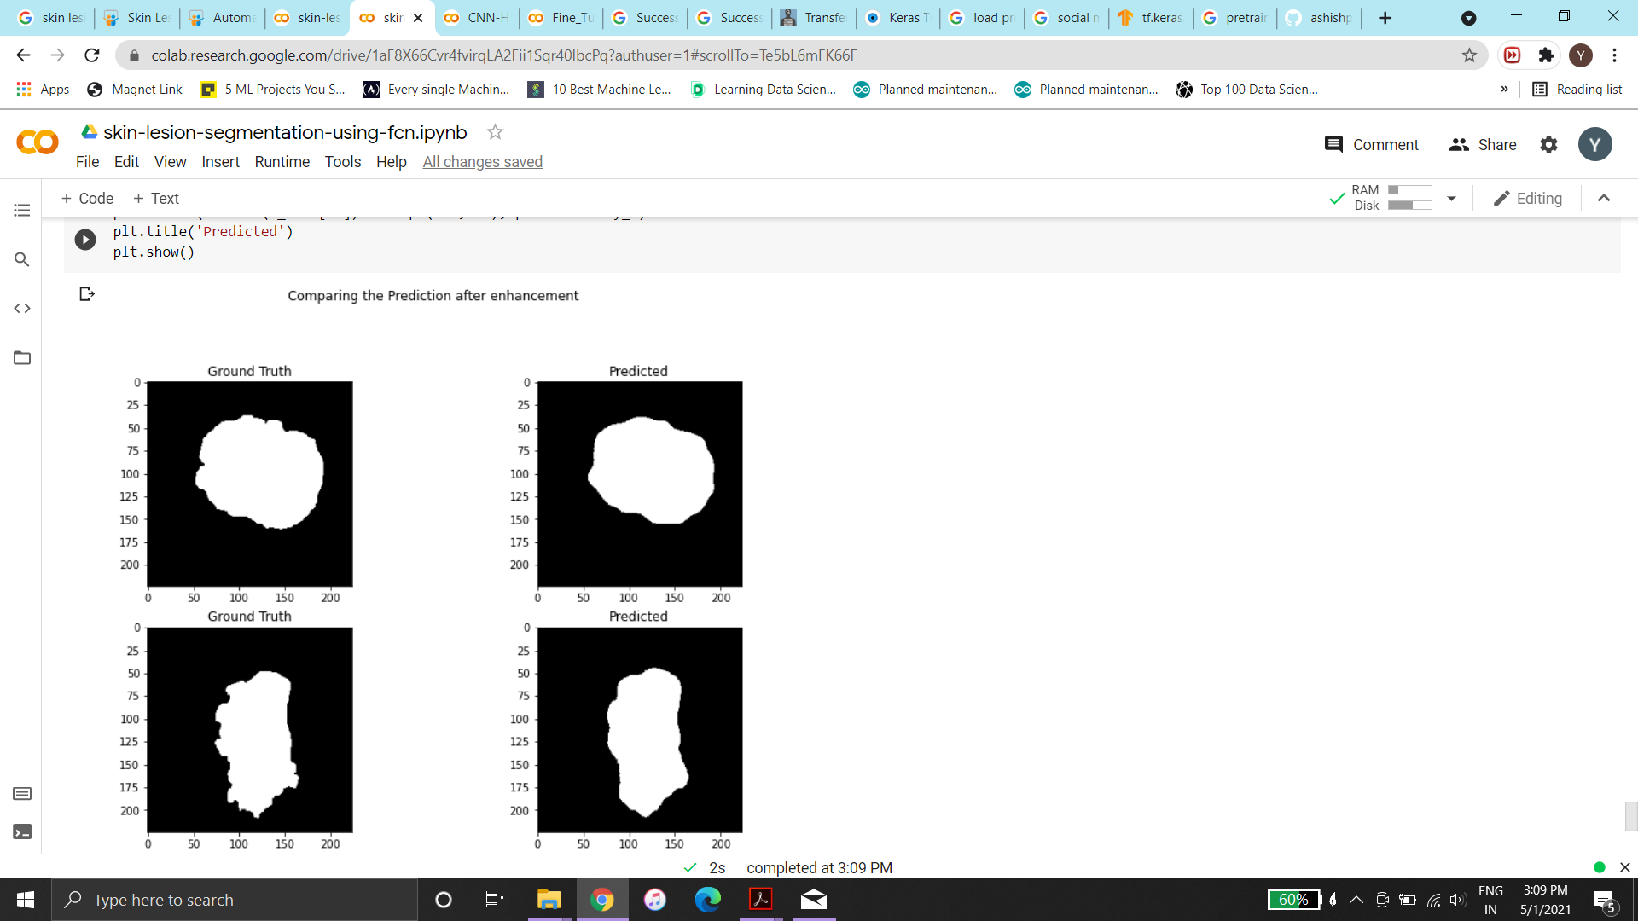
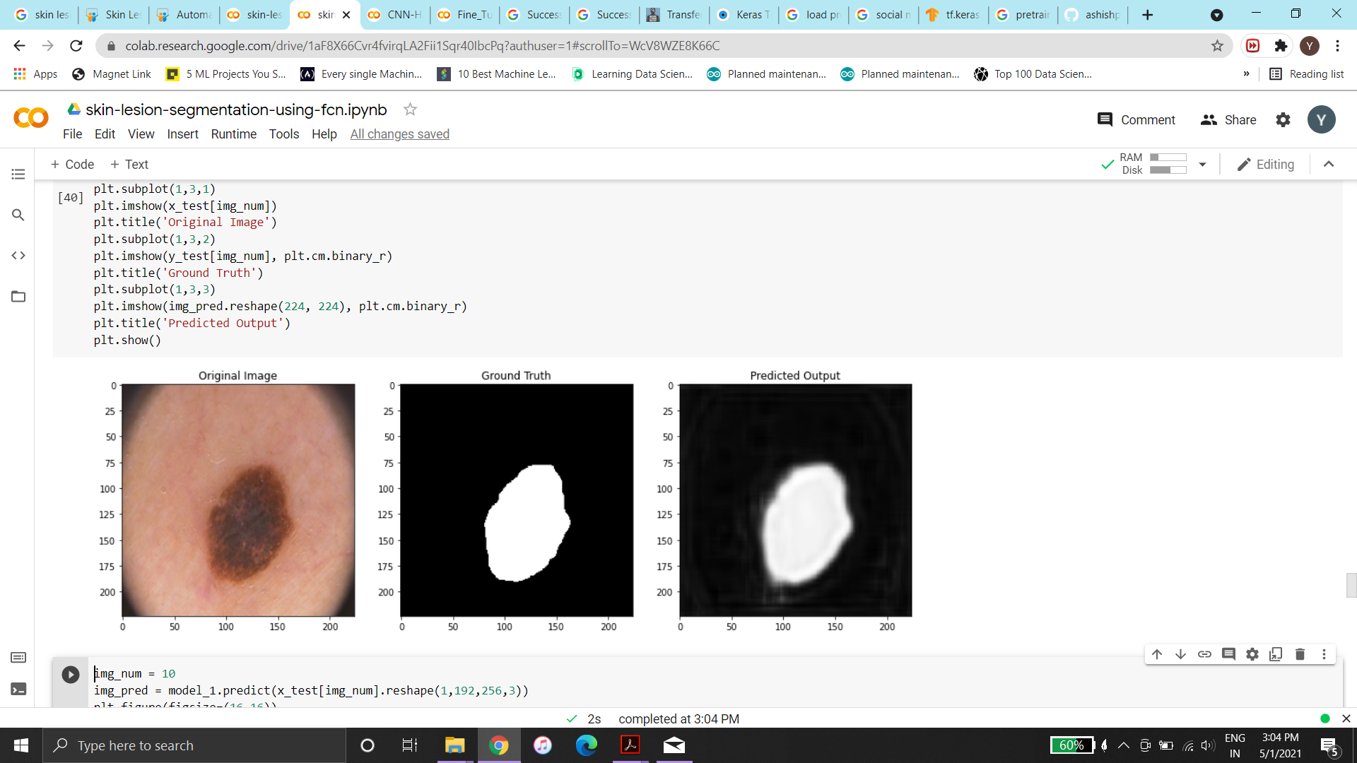
Results of Skin Lesion Segmentation(FCN)

Slide 21
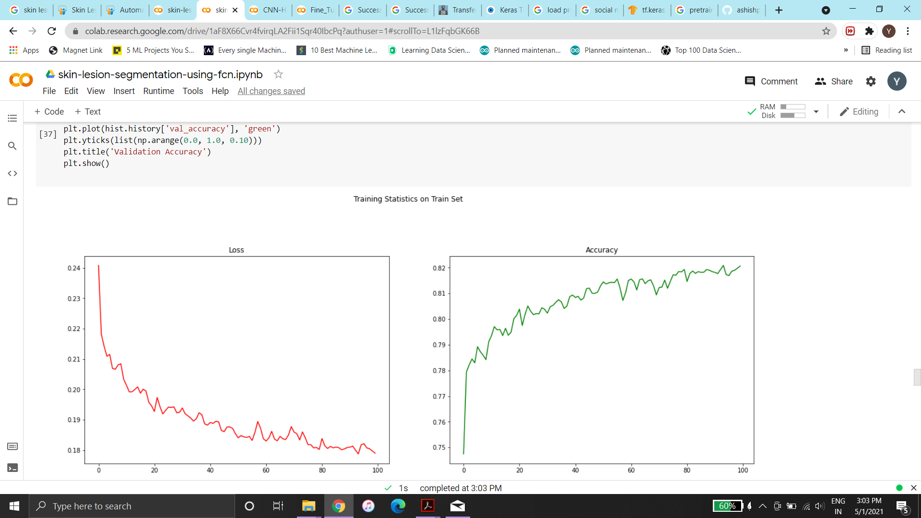
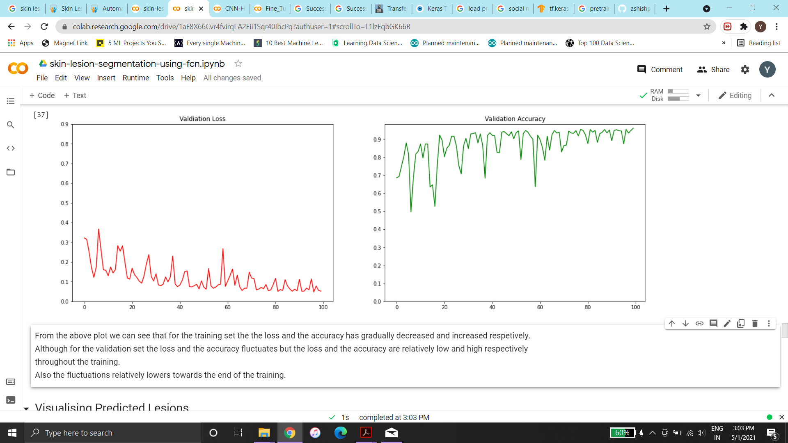

Slide 22
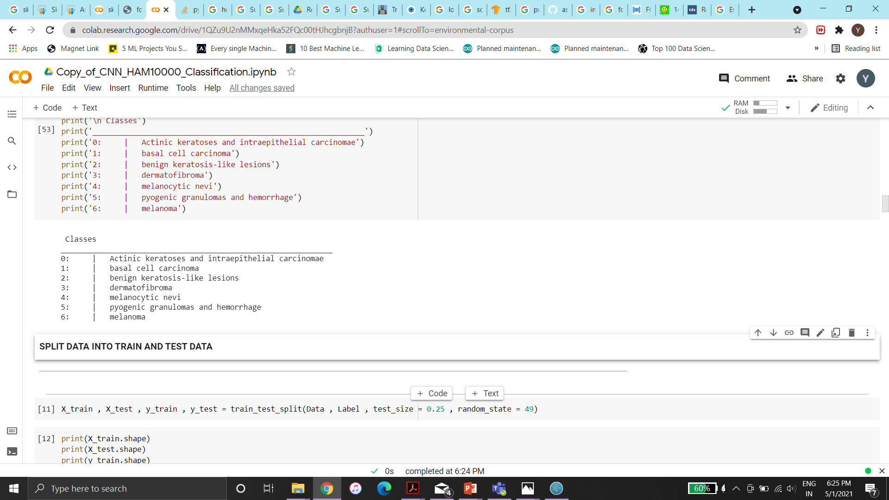
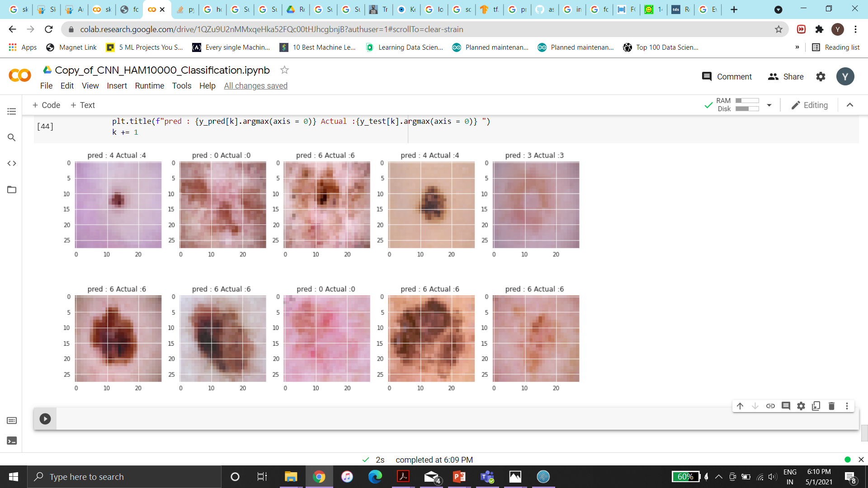
Results of Skin Lesion Classification

Slide 23
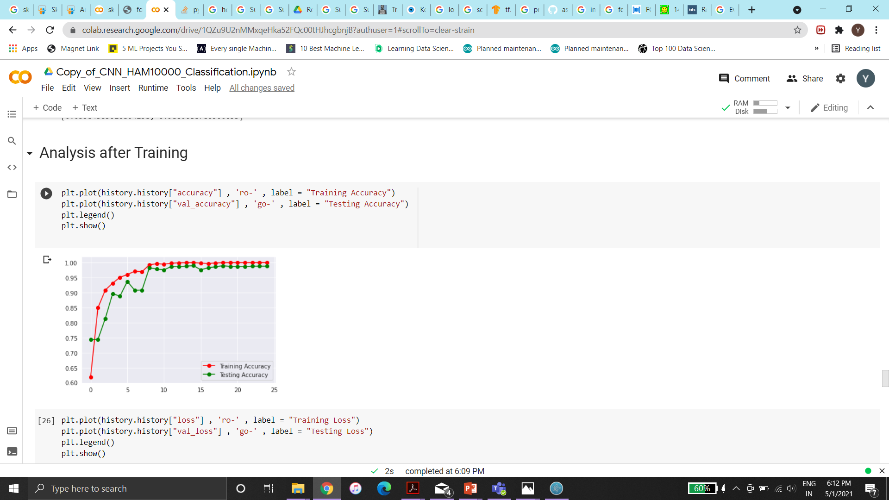
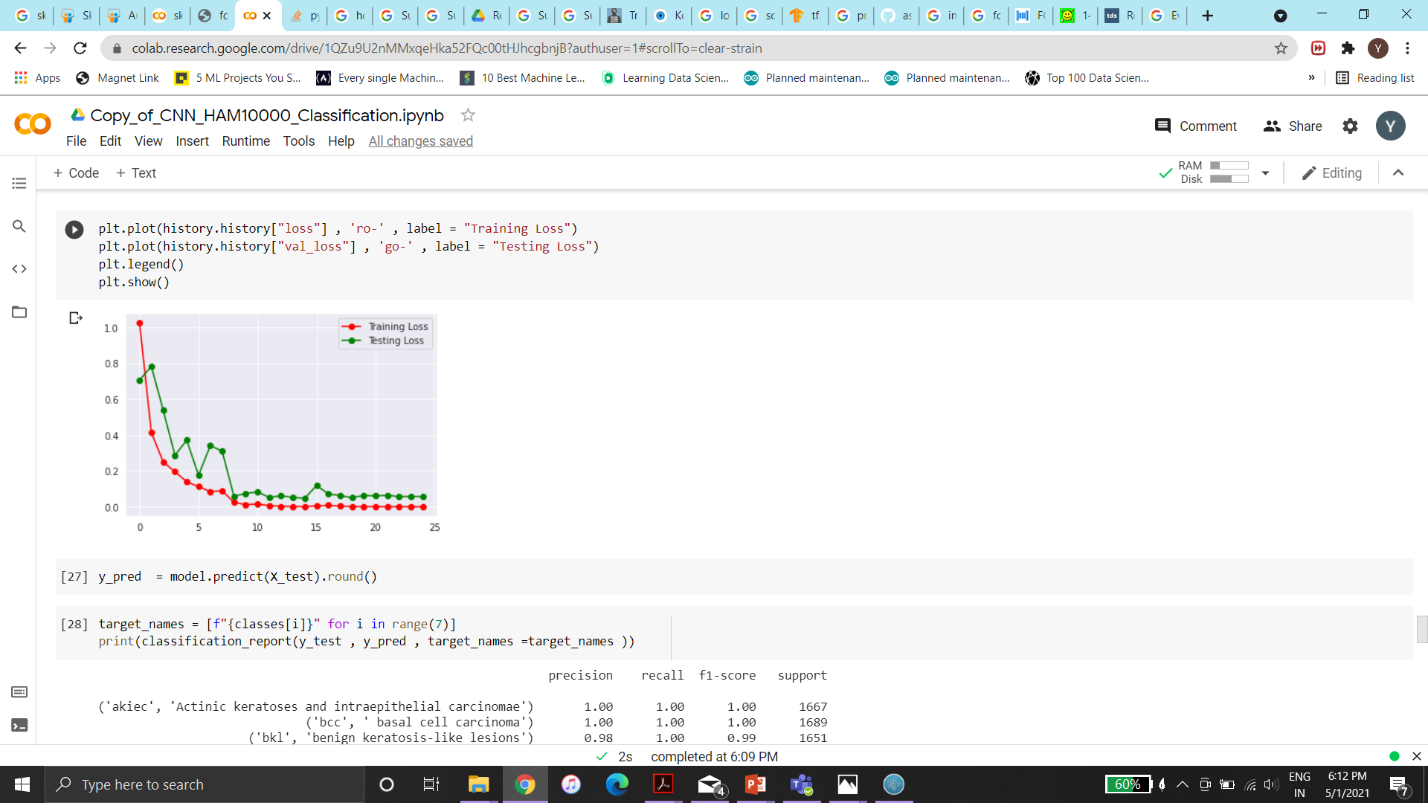

Slide 24
References:
[1] F. Peruch, F. Bogo, M. Bonazza, V.-M. Cappelleri, and E. Peserico, “Simpler, faster, more accurate melanocytic lesion segmentation through meds,” IEEE Trans. Biomed. Eng., vol. 61, no. 2, pp. 557–565, 2014.
[2] H. Zhou, X. Li, G. Schaefer, M. E. Celebi, and P. Miller, “Mean shift based gradient vector flow for image segmentation,” Comput. Vis. Image Understand., vol. 117, no. 9, pp. 1004–1016, 2013.
[3] A. R. Sadri, M. Zekri, S. Sadri, N. Gheissari, M. Mokhtari, and F. Kolahdouzan, “Segmentation of dermoscopy images using wavelet networks,” IEEE Trans. Biomed. Eng., vol. 60, no. 4, pp. 1134–1141, 2013.
[4] F. Xie and A. C. Bovik, “Automatic segmentation of dermoscopy images using self-generating neural networks seeded by genetic algorithm,” Pattern Recognition, vol. 46, no. 3, pp. 1012–1019, 2013.
[5] M. E. Celebi, Q. Wen, H. Iyatomi, K. Shimizu, H. Zhou, and G. Schaefer, “A state-of-the-art survey on lesion border detection in dermoscopy images,” pp. 97–129, 2015.
[6] Y. LeCun, L. Bottou, Y. Bengio, and P. Haffner, “Gradient-based learning applied to document recognition,” Proceedings of the IEEE, vol. 86, no. 11, pp. 2278–2324, 1998
[7]M. H. Jafari, E. Nasr-Esfahani, N. Karimi, S. Soroushmehr, S. Samavi, and K. Najarian, “Extraction of skin lesions from non-dermoscopic images using deep learning,” arXiv preprint arXiv:1609.02374, 2016.

